Slide 1
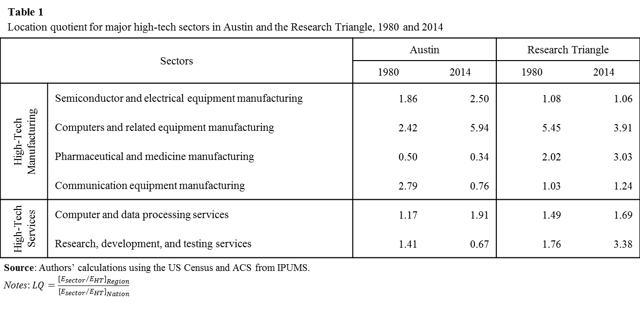
Table 1 Location quotient for major high-tech sectors in Austin and the Research Triangle, 1980 and 2014
Sectors |  | Austin |  | Research Triangle
 |  | 1980 | 2014 | 1980 | 2014
High-Tech Manufacturing | Semiconductor and electrical equipment manufacturing | 1.86 | 2.50 | 1.08 | 1.06
 | Computers and related equipment manufacturing | 2.42 | 5.94 | 5.45 | 3.91
 | Pharmaceutical and medicine manufacturing | 0.50 | 0.34 | 2.02 | 3.03
 | Communication equipment manufacturing | 2.79 | 0.76 | 1.03 | 1.24
High-Tech Services | Computer and data processing services | 1.17 | 1.91 | 1.49 | 1.69
 | Research, development, and testing services | 1.41 | 0.67 | 1.76 | 3.38
Source: Authors’ calculations using the US Census and ACS from IPUMS. Notes: $LQ=\frac{{[{E_{sector}}/{E_{HT}]}}_{Region}}{{[{E_{sector}}/{E_{HT}]}}_{Nation}}$

Slide 2
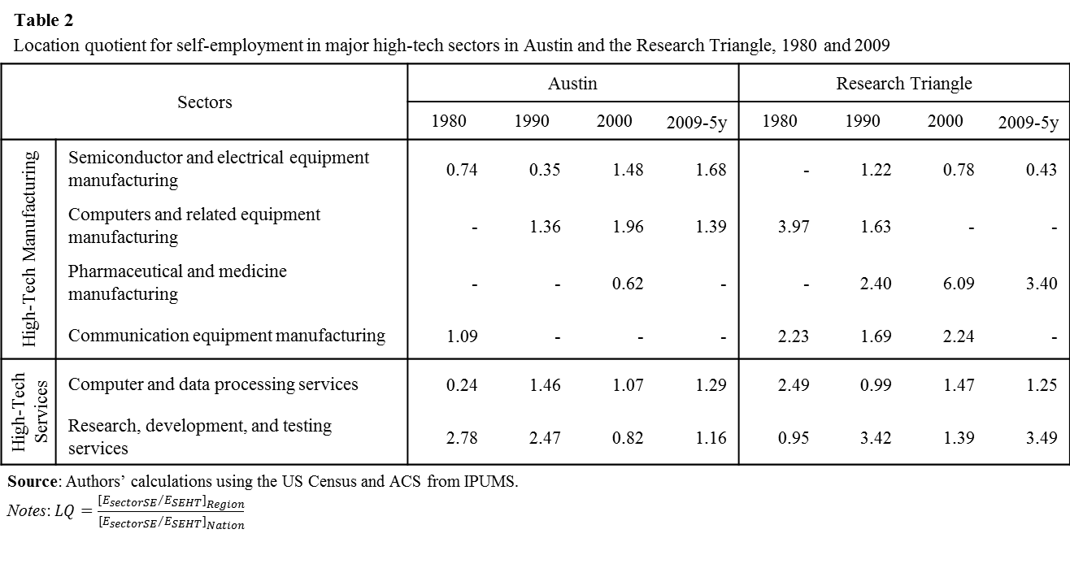
Table 2 Location quotient for self-employment in major high-tech sectors in Austin and the Research Triangle, 1980 and 2009
Sectors |  | Austin |  |  |  | Research Triangle
 |  | 1980 | 1990 | 2000 | 2009-5y | 1980 | 1990 | 2000 | 2009-5y
High-Tech Manufacturing | Semiconductor and electrical equipment manufacturing | 0.74 | 0.35 | 1.48 | 1.68 | - | 1.22 | 0.78 | 0.43
 | Computers and related equipment manufacturing | - | 1.36 | 1.96 | 1.39 | 3.97 | 1.63 | - | -
 | Pharmaceutical and medicine manufacturing | - | - | 0.62 | - | - | 2.40 | 6.09 | 3.40
 | Communication equipment manufacturing | 1.09 | - | - | - | 2.23 | 1.69 | 2.24 | -
High-Tech Services | Computer and data processing services | 0.24 | 1.46 | 1.07 | 1.29 | 2.49 | 0.99 | 1.47 | 1.25
 | Research, development, and testing services | 2.78 | 2.47 | 0.82 | 1.16 | 0.95 | 3.42 | 1.39 | 3.49
Source: Authors’ calculations using the US Census and ACS from IPUMS. Notes: $LQ=\frac{{[{E_{sectorSE}}/{E_{SEHT}]}}_{Region}}{{[{E_{sectorSE}}/{E_{SEHT}]}}_{Nation}}$

Slide 3
Figure 1
Population of Austin and the Research Triangle, 1980 and 2013.
Source: Authors’ calculations using the US Census and ACS from IPUMS.
Notes: Austin defined as Austin-San Marcos MSA/Austin-Round Rock MSA (Bastrop, Caldwell, Hays, Travis, and Williamson counties), Research Triangle defined as Chatham, Durham, Orange, and Wake counties with the addition of Lee county in 2013.

Slide 5
 | 1980 | 1990 | 2000 | 2009-5y | 2014
Austin | 1.08 | 1.25 | 1.61 | 1.51 | 1.47
Research Triangle | 1.04 | 1.32 | 1.67 | 1.61 | 1.56
Silicon Valley | 2.14 | 2.14 | 2.51 | 2.36 | 2.28

Slide 6
 | 1980 | 1990 | 2000 | 2009-5y
Austin | 1.48 | 1.61 | 1.51 | 1.47
Research Triangle | 0.88 | 1.24 | 1.68 | 1.67
Silicon Valley | 1.98 | 1.94 | 1.98 | 1.87

Slide 7
Table 3 Number of workers for top 10 high-tech sectors in Austin, the Research Triangle, and for equivalent sectors in the U.S. in 1980 and 2013
Sectors |  | Austin |  |  |  | Research Triangle |  |  |  | United States ^{a]}
 |  | 1980 (Thousands) |  | 2014 (Thousands) |  | 1980 (Thousands) |  | 2014 (Thousands) |  | 1980 (Hundred Thousands) |  | 2014 (Hundred Thousands)
High-Tech Manufacturing | Semiconductor and electrical equipment manufacturing | 7.50 |  | 24.57 |  | 4.62 |  | 8.63 |  | 13.85 |  | 9.82
 | Computers and related equipment manufacturing | 3.18 |  | 10.21 |  | 7.62 |  | 5.55 |  | 4.53 | * | 1.72 | *
 | Pharmaceutical and medicine manufacturing | 0.32 | * | 1.77 | * | 1.38 | * | 12.97 |  | 2.21 | * | 5.18 | *
 | Communication equipment manufacturing | 5.14 |  | 1.12 | * | 2.02 |  | 1.51 | * | 6.35 |  | 1.48 | *
High-Tech Services | Computer and data processing services | 1.30 |  | 48.09 |  | 1.76 |  | 35.07 |  | 3.82 | * | 25.11
 | Engineering, architectural, and surveying services | 3.06 |  | 17.24 |  | 2.10 |  | 10.61 |  | 6.20 |  | 15.73
 | Research, development, and testing services | 1.60 |  | 4.20 | * | 2.12 |  | 17.58 |  | 3.89 | * | 6.29 | *
Other High-Tech Services ^{b]} | Management and public relations services | 1.10 | * | 14.78 |  | 1.82 |  | 10.92 |  | 3.84 | * | 16.76
 | Banking | 4.46 |  | 10.73 |  | 4.52 |  | 11.64 |  | 18.76 |  | 21.19
 | Telecommunications and internet service providers | 3.00 |  | 10.82 |  | 3.60 |  | 8.25 |  | 11.97 |  | 12.23
 | Security, brokerage, and investment companies | 0.92 | * | 10.30 |  | 0.60 | * | 9.08 |  | 3.59 | * | 12.38
 | Electric power generation, transmission, distribution | 1.72 |  | 5.33 |  | 3.70 |  | 3.83 | * | 6.47 |  | 6.97
Total High-Tech Employment |  | 38.98 |  | 183.67 |  | 41.42 |  | 151.89 |  | 134.19 |  | 181.59
Source: Authors’ calculations using the US Census and ACS from IPUMS. Notes: * indicates the sector was not in the top 10 high-tech sectors for that specific region and year. a] U.S. data are for sectors in the top 10 for either Austin or the Research Triangle regions, but not necessarily for the U.S. Missing top 10 high-tech industries in the U.S. but not in either region include: industrial machinery manufacturing, aerospace product manufacturing, and chemical product and preparation manufacturing. b] The oil and gas extraction sector is omitted from the top 10 because in the case of Austin it most likely indicates the presence of fracking which is not a high-tech sector.

